Slide 1





SPRING BOOT PROJECT
LECTURE - 3

Slide 2

Today’s Agenda
What Is Validation ?
How Spring Boot Supports Validation ?
Steps Needed For Adding Validation
Example
Handling Updates

Slide 3
What Is Validation In Spring Boot ?
Validation or Bean Validation in Spring Boot applications is the process of ensuring that incoming data is CORRECT before processing or saving to a database.
Benefits ?
Prevents errors.
Improves overall quality of the application.
Ensure data consistency.

Slide 4
How Spring Boot Supports Validation ?
Spring Boot provides built-in support for validation using Java Bean Validation API which is now called Jakarta Validation API.
This dependency provides a set of annotations and interfaces to define and validate constraints.

Slide 5
Steps Needed For Adding Validation
1. Add the Validator dependency which is known as spring-boot-starter-validation.
2. Apply the necessary validation annotations to fields of the bean/entity.
3. Enable validation on Spring Rest Controller.
4. Finally, handle validation errors in your Global Exception Handler class.

Slide 6
Step 1: Adding The Dependency
<dependency>
<groupId>org.springframework.boot</groupId>
<artifactId>spring-boot-starter-validation</artifactId>
</dependency>

Slide 7
Step 2: Applying The Validation Annotations
Bean Validation works by adding constraint annotations on the fields of the class to be validated.
These annotations are defined in a package called jakarta.validation.constraint.

Slide 8
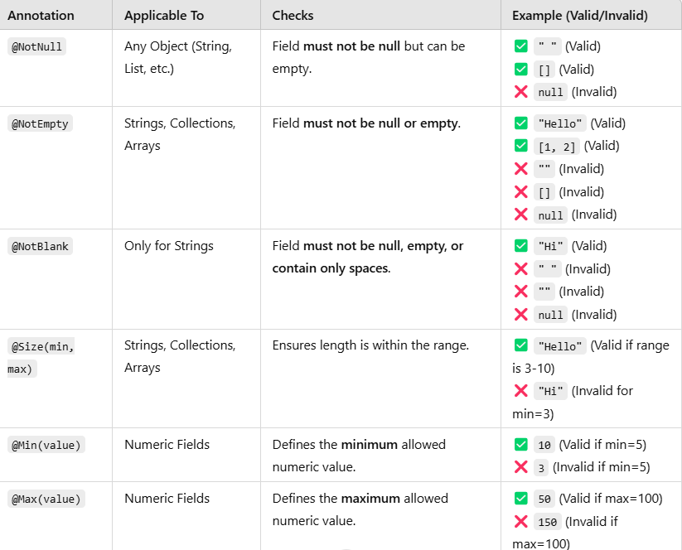
Most Common Validation Annotations

Slide 9
Step 2: Applying The Validation Annotations
package in.scalive.entity;
import jakarta.persistence.Entity;
import jakarta.persistence.GeneratedValue;
import jakarta.persistence.GenerationType;
import jakarta.persistence.Id;
import jakarta.validation.constraints.Min;
import jakarta.validation.constraints.NotBlank;
import jakarta.validation.constraints.NotNull;
import lombok.AllArgsConstructor;
import lombok.Data;
import lombok.NoArgsConstructor;
@Entity
@Data
@AllArgsConstructor
@NoArgsConstructor
public class Emp {
@Id
@GeneratedValue(strategy = GenerationType.IDENTITY)
private Integer empId;
@NotBlank(message = "Emp name is required")
private String ename;
@NotNull(message = "Salary is required")
@Min(value = 10000,message="Salary must be atleast 10000")
private Double sal;
}

Slide 10
Step 3: Enable Validation In REST Controller
In order for Spring to use constraints defined for validation in Entity/Bean class we need to annotate the RequestBody in Rest Controller with the @Valid annotation .
When the validation fails then MethodArgumentNotValidException is thrown.
Spring by default translates this exception to HTTP 400.

Slide 11
Step 3: Enable Validation In REST Controller
package in.scalive.controller;
import org.springframework.web.bind.annotation.GetMapping;
import org.springframework.web.bind.annotation.PathVariable;
import org.springframework.web.bind.annotation.PostMapping;
import org.springframework.web.bind.annotation.PutMapping;
import org.springframework.web.bind.annotation.RequestBody;
import org.springframework.web.bind.annotation.RequestMapping;
import org.springframework.web.bind.annotation.RestController;
import in.scalive.entity.Emp;
import in.scalive.service.EmpService;
import jakarta.validation.Valid;
@RestController
@RequestMapping("/api/emp")
public class EmpController {
private EmpService serv;
public EmpController(EmpService serv) {
this.serv = serv;
}

Slide 12
Step 3: Enable Validation In REST Controller
@PostMapping("/add")
public String addEmp(@RequestBody @Valid Emp empToAdd) {
return serv.addEmp(empToAdd);
}
@GetMapping("/{empId}")
public Emp getEmp(@PathVariable("empId")Integer empId) {
return serv.getEmp(empId);
}
@PutMapping("/update/{empId}")
public String updateEmp(@RequestBody Emp updatedEmp,@PathVariable("empId")Integer empId) {
return serv.updateEmp(updatedEmp,empId);
}
}

Slide 13
Step 4: Handle Validation Error
When Spring Boot finds a method argument which is annotated with @Valid, it automatically validates the argument.
When the target method argument fails to pass the validation then Spring Boot throws a MethodArgumentNotValidException exception.
We should handle the MethodArgumentNotValidException inside our Exception handler class otherwise Spring Boot’s default error handler will run and show the detailed error response.

Slide 14
Step 4: Handle Validation Error
@ExceptionHandler(MethodArgumentNotValidException.class)
public ResponseEntity<Map<String, String>> handleValidationErrors(MethodArgumentNotValidException ex) {
Map<String, String> errors = new HashMap<>();
BindingResult bResult=ex.getBindingResult();
List<FieldError>errorList=bResult.getFieldErrors();
for (FieldError error : errorList) {
errors.put(error.getField(), error.getDefaultMessage());
}
return new ResponseEntity<>(errors, HttpStatus.BAD_REQUEST);
}

Slide 15
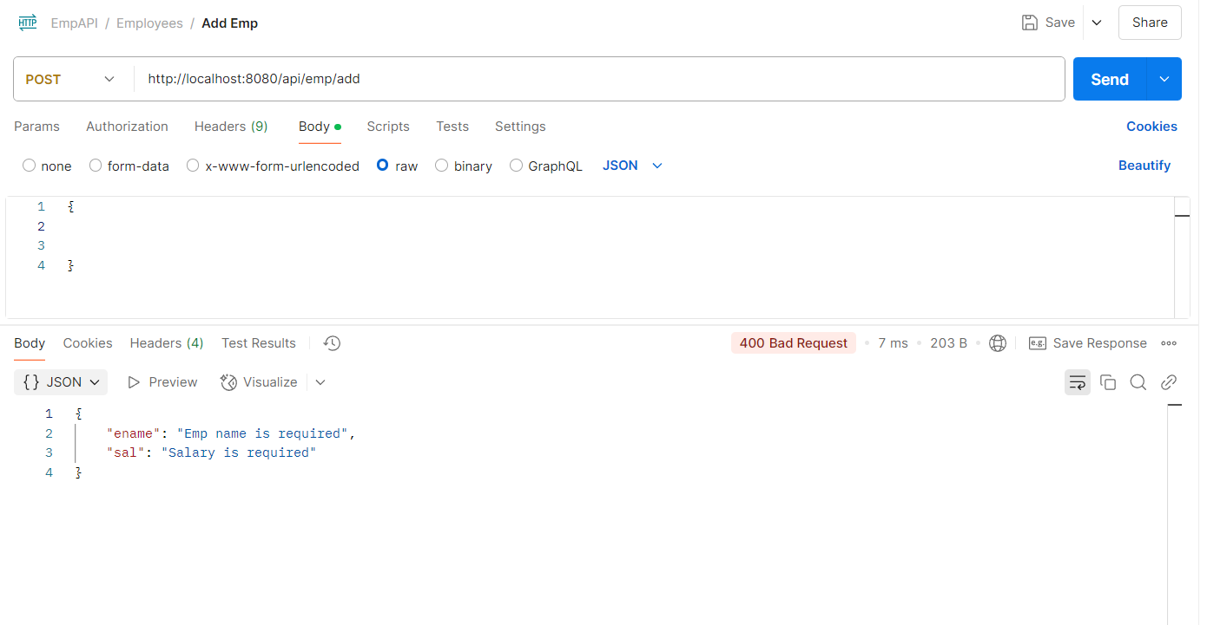
Testing Using Postman
Adding A New Emp With Missing Fields

Slide 16
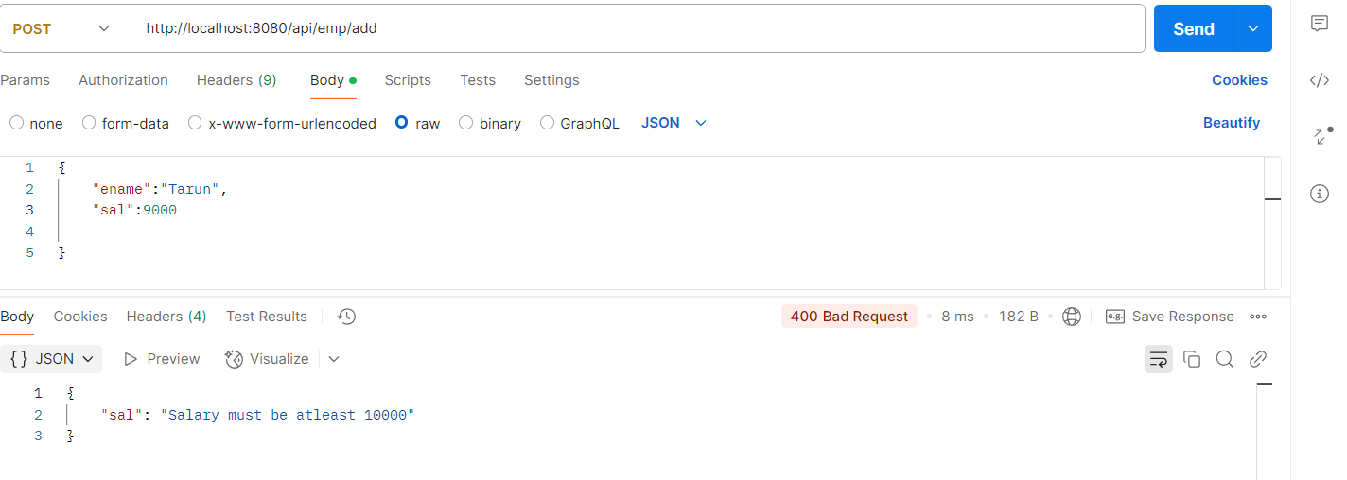
Testing Using Postman
Adding A New Emp With Invalid Data

Slide 17
A Problem With Our Code !
Although our code will properly handle validation errors while adding a new Emp but when we update an employee by passing partial data ( like we just want to update salary) then it will throw exception.
Can you guess why ?

Slide 18
A Problem With Our Code !
That’s happening because when we update an employee by passing only the sal (salary) field in the request body, the ename field is null.
Since ename has the @NotBlank validation constraint, the Hibernate Validator will reject the update.

Slide 19
So What’s The Solution ?
Instead of sending the full Emp entity, use a DTO for updates.
This avoids sending unnecessary fields in requests.
Allows safe updates without validation errors.

Slide 20
Steps Needed
Create a DTO class with the ename and sal members.
Add @Size on ename and apply @Min on sal .
This will ensure that we can update any of the fields but we must provide the minimum required value.
Modify the Service class so that it only updates non-null fields.
In the Rest Controller class use @Valid at method parameter where DTO is received.
Finally if the validation fails then Spring will throw a MethodArgumentNotValidException , so we must handle it in our Global exception handler class.

Slide 21
The DTO Class
package in.scalive.dto;
import jakarta.validation.constraints.Min;
import jakarta.validation.constraints.Size;
import lombok.Getter;
import lombok.Setter;
@Getter
@Setter
public class EmpUpdateDTO {
@Size(min = 1, message = "Ename cannot be empty")
private String ename;
@Min(value = 10000, message = "Salary must be at least 10000")
private Double sal;
}

Slide 22
The Service Class
public String updateEmp(EmpUpdateDTO empDTO,Integer empId) {
Emp existingEmp=repo.findById(empId).orElse(null);
if(existingEmp==null) {
throw new NoSuchEmpExistsException("Emp with id:"+empId+" does not exists");
}
if(empDTO.getEname()==null && empDTO.getSal()==null) {
throw new RuntimeException("Empty object not allowed!");
}
if (empDTO.getEname() != null && empDTO.getEname().isBlank()) {
throw new RuntimeException("Ename cannot be just spaces");
}
if (empDTO.getEname() != null) {
existingEmp.setEname(empDTO.getEname());
}
if (empDTO.getSal() != null) {
existingEmp.setSal(empDTO.getSal());
}
repo.save(existingEmp);
return "Emp updated successfully!";
}

Slide 23
The Rest Controller Class
package in.scalive.controller;
import org.springframework.validation.annotation.Validated;
import org.springframework.web.bind.annotation.GetMapping;
import org.springframework.web.bind.annotation.PathVariable;
import org.springframework.web.bind.annotation.PostMapping;
import org.springframework.web.bind.annotation.PutMapping;
import org.springframework.web.bind.annotation.RequestBody;
import org.springframework.web.bind.annotation.RequestMapping;
import org.springframework.web.bind.annotation.RestController;
import in.scalive.dto.EmpUpdateDTO;
import in.scalive.entity.Emp;
import in.scalive.service.EmpService;
import jakarta.validation.Valid;
@RestController
@RequestMapping("/api/emp")
public class EmpController {
private EmpService serv;
public EmpController(EmpService serv) {
this.serv = serv;
}

Slide 24
The Rest Controller Class
@PostMapping("/add")
public String addEmp(@RequestBody @Valid Emp empToAdd) {
return serv.addEmp(empToAdd);
}
@GetMapping("/{empId}")
public Emp getEmp(@PathVariable("empId")Integer empId) {
return serv.getEmp(empId);
}
@PutMapping("/update/{empId}")
public String updateEmp(@Valid @RequestBody EmpUpdateDTO empDTO,@PathVariable("empId")Integer empId) {
return serv.updateEmp(empDTO,empId);
}
}

Slide 25
The GlobalExceptionHandler Class
@ExceptionHandler(MethodArgumentNotValidException.class)
public ResponseEntity<Map<String, String>> handleValidationErrors(MethodArgumentNotValidException ex) {
Map<String, String> errors = new HashMap<>();
BindingResult bResult=ex.getBindingResult();
List<FieldError>errorList=bResult.getFieldErrors();
for (FieldError error : errorList) {
errors.put(error.getField(), error.getDefaultMessage());
}
return new ResponseEntity<>(errors, HttpStatus.BAD_REQUEST);
}
@ExceptionHandler(Exception.class)
public ResponseEntity<ErrorResponse> handleGeneralException(Exception ex) {
ErrorResponse error=new ErrorResponse(HttpStatus.INTERNAL_SERVER_ERROR.value(), ex.getMessage());
return new ResponseEntity<>(error,HttpStatus.INTERNAL_SERVER_ERROR);
}

Slide 26
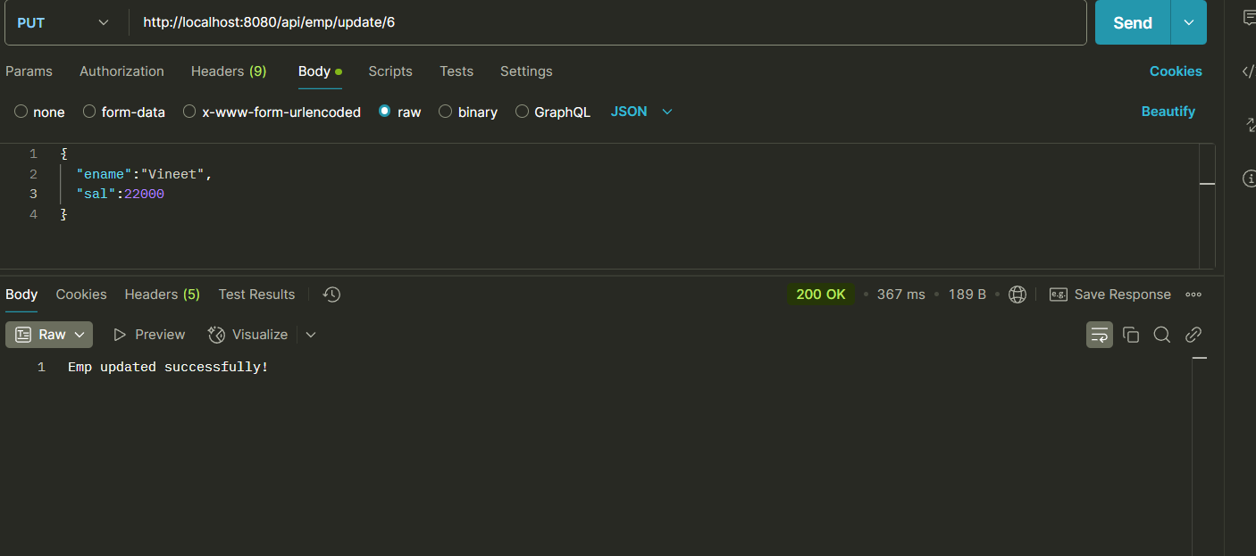
Testing Using Postman
Updating Both Fields

Slide 27
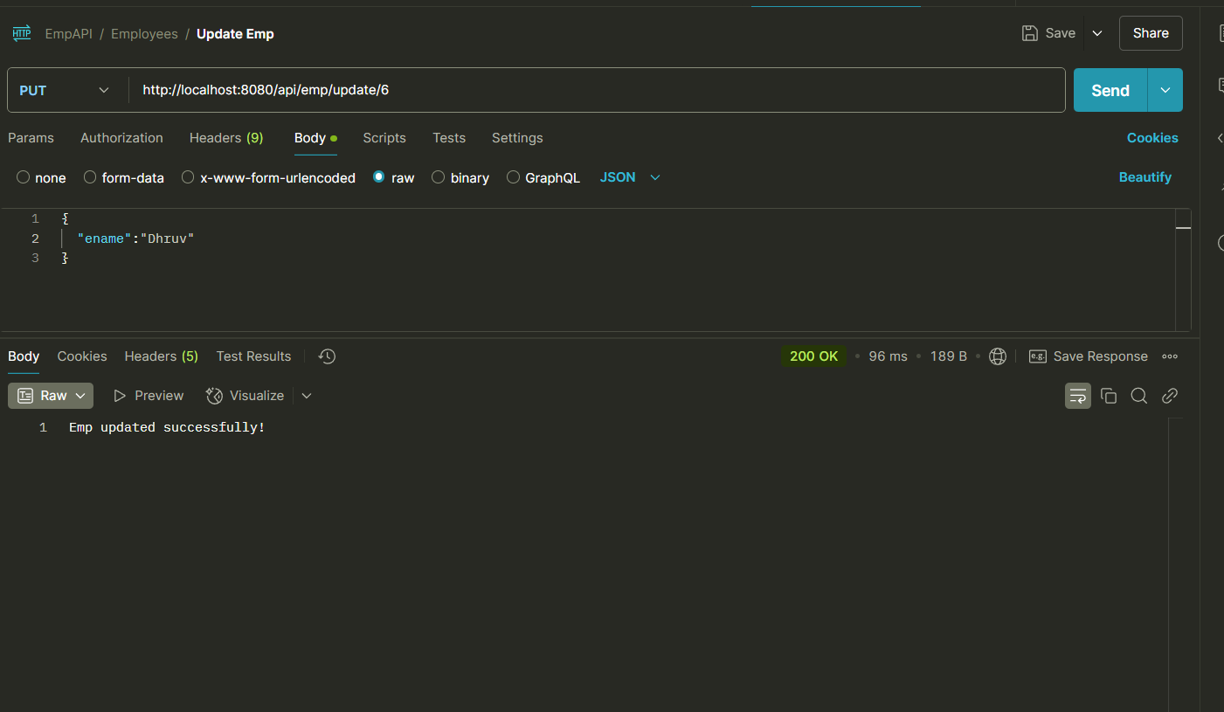
Testing Using Postman
Updating Only ename

Slide 28
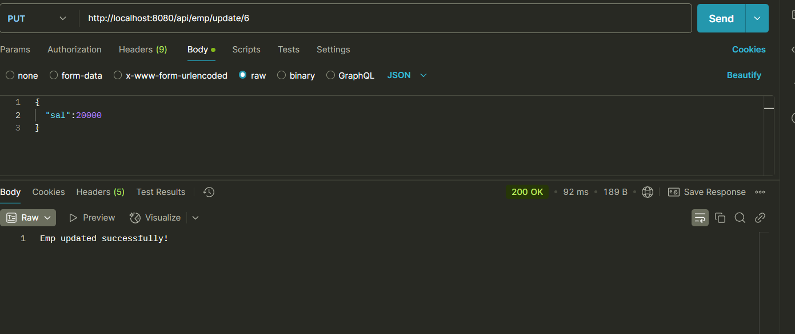
Testing Using Postman
Updating Only sal

Slide 29
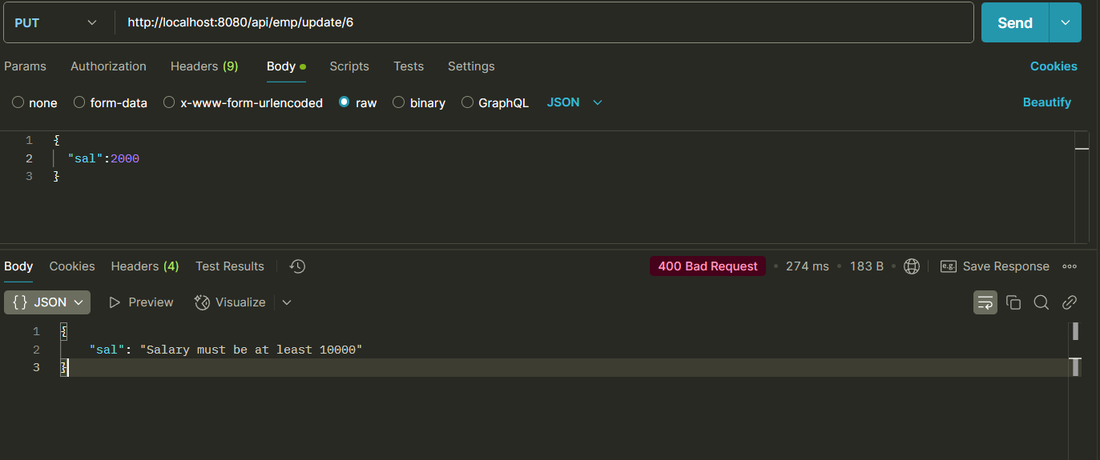
Testing Using Postman
Updating sal With Invalid Value

Slide 30
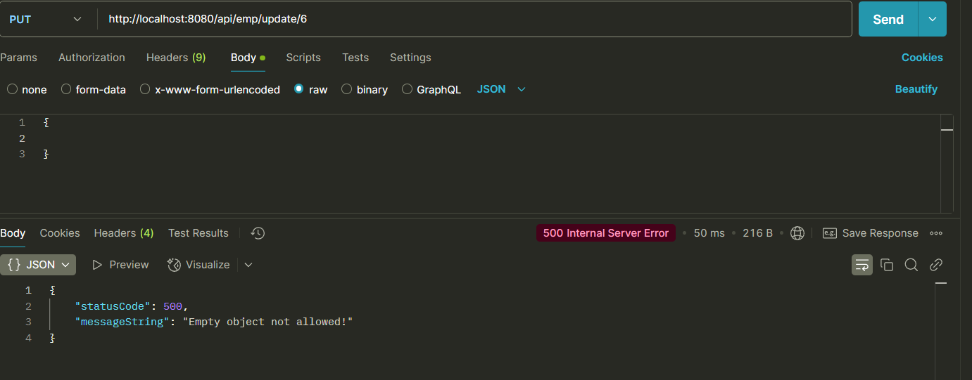
Testing Using Postman
Passing Empty Object For Update

Slide 31
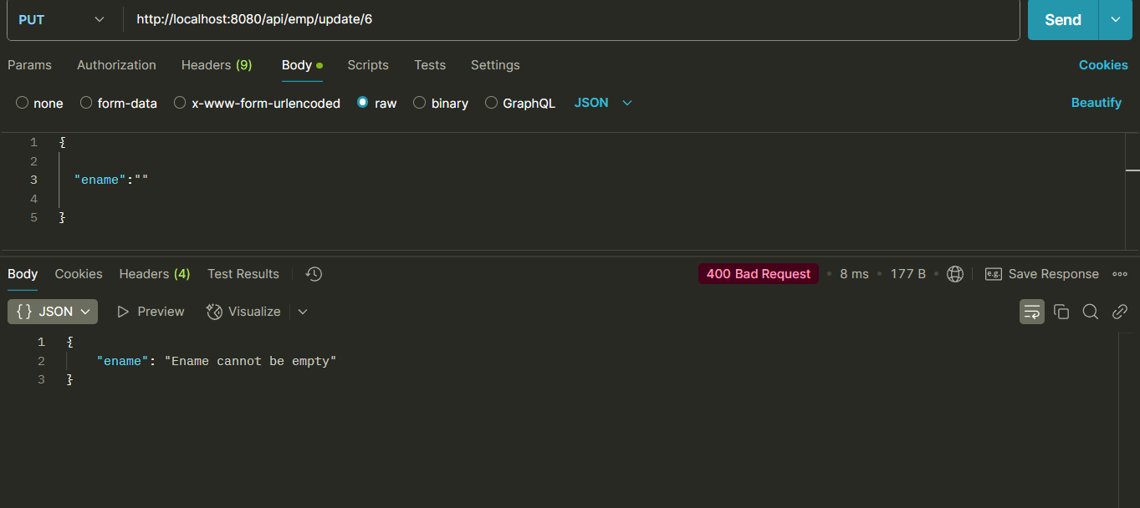
Testing Using Postman
Passing Blank Ename

Slide 32
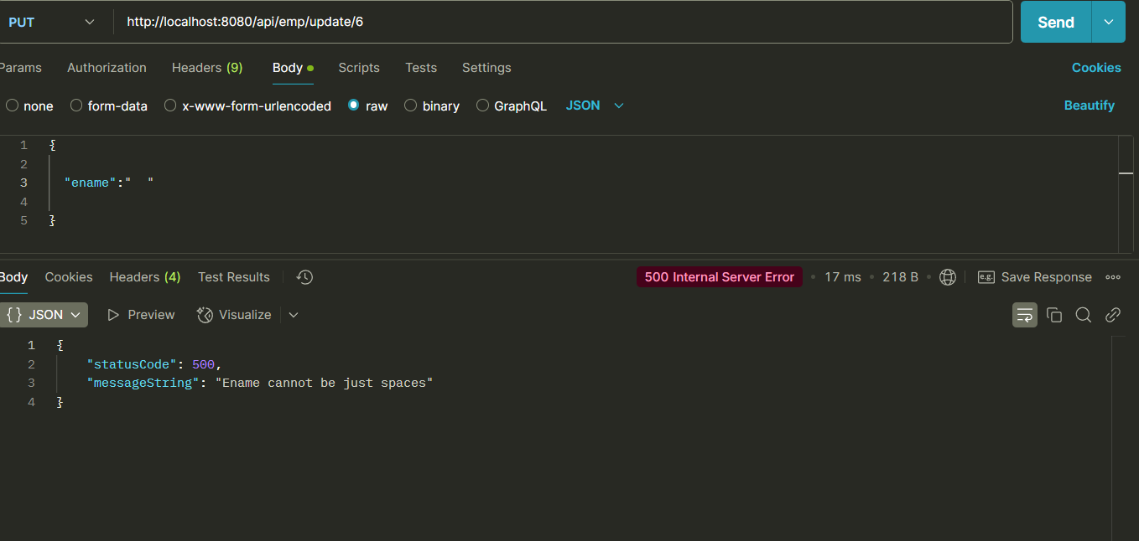
Testing Using Postman
Passing Empty Spaces In Ename

